Slide 1








Visa Application Approval
Prediction (EasyVisa)
Ensemble Techniques
and Model Tuning
Joseph Anyanwu

Slide 2

Contents / Agenda
Business Problem Overview and Solution Approach
EDA Results
Data Preprocessing
Model Building and Hyperparameter Tuning
Model Performance Comparison and Final Model Selection
Important Feature based on Final Model
Executive Summary

Slide 3
Executive Summary
The profile of the applicants for whom the visa status can be approved:
Primary information to look at:
Education level - At least has a Bachelor's degree - Master's and doctorate are preferred.
Job Experience - Should have some job experience.
Prevailing wage - The median prevailing wage of the employees for whom the visa got certified is around 72k.
Secondary information to look at:
Unit of Wage - Applicants having a yearly unit of wage.
Continent - Ideally, the nationality and ethnicity of an applicant shouldn't matter to work in a country, but previously it has been observed that applicants from Europe, Africa, and Asia have higher chances of visa certification.
Region of employment – Analysis shows that the Midwest region has more chances of visa approval.

Slide 4
Executive Summary
The profile of the applicants for whom the visa status can be denied:
Primary information to look at:
Education level - Doesn't have any degree and has completed high school.
Job Experience – Doesn’t have any job experience.
Prevailing wage - The median prevailing wage of the employees for whom the visa was denied is around 65k.
Secondary information to look at:
Unit of Wage - Applicants having an hourly unit of wage.
Continent - Ideally, the nationality and ethnicity of an applicant shouldn't matter to work in a country, but previously it has been observed that applicants from South America, North America, and Oceania have a higher chance of a visa being denied.
Region of employment – Analysis shows that the Midwest region has more chances of visa approval.

Slide 5
Executive Summary
Additional information of employers and employees can be collected to gain better insights. Information such as:
Employers’ information about the wage they are offering to the applicant, the sector in which the company operates, etc.
Employee’s Specialization in their educational degree, Number of years of experience, etc.

Slide 6
Business Problem Overview and Solution Approach
OFLC processes job certification applications for employers seeking to bring foreign workers into the United States and grants certifications in those cases where employers can demonstrate that there are not sufficient US workers available to perform the work at wages that meet or exceed the wage paid for the occupation in the area of intended employment.
The process of reviewing every case is becoming a tedious task as the number of applicants is increasing every year. In FY 2016, the OFLC processed 775,979 employer applications for 1,699,957 positions under temporary and permanent labor certifications, a 9% increase over the previous year.
The task at hand to analyze the data provided to facilitate the process of visa approvals by building a machine learning model and to recommend a suitable profile for the applicants for whom the visa should be certified or denied based on the drivers that significantly influence the case status.

Slide 7
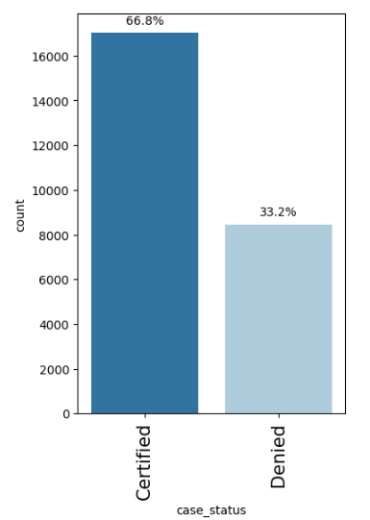
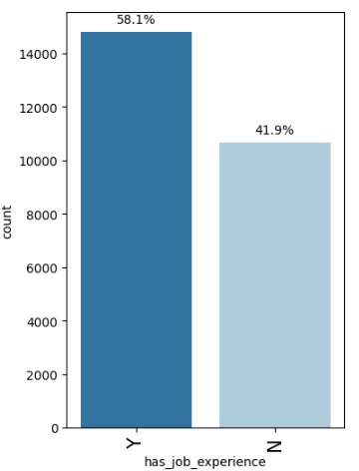
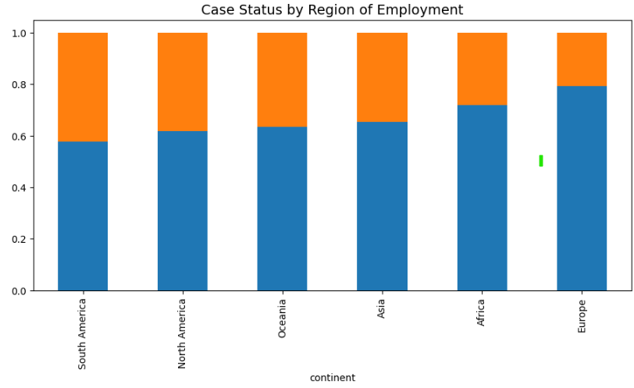
Exploratory Data Analysis Results
66.8% of the visas were certified
58.1% of the applicants have job experience.
Applications from Europe and Africa have a higher chance of getting certified, with 79% and 72%, respectively.
Asia has the third-highest percentage (Around 60%) of visa certification and has the highest number of applications.
The continent of South America has the lowest rate at 58%.

Slide 8
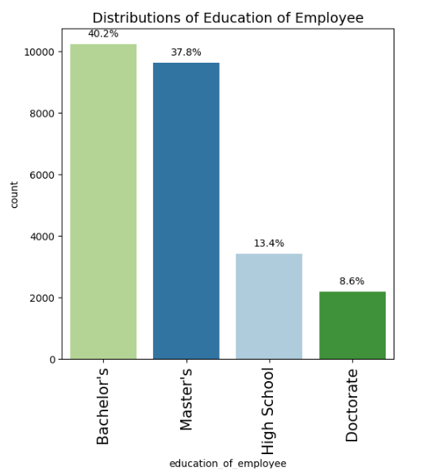
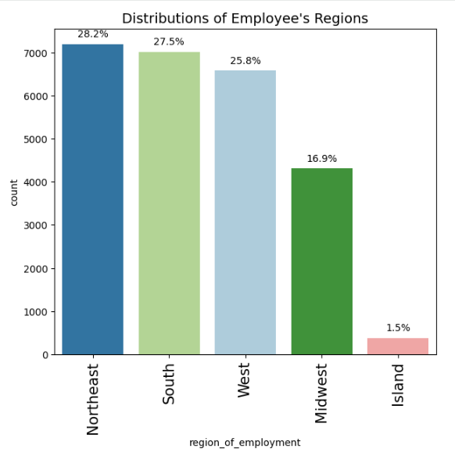
EDA Results – Education & Employment Region
40.2% of the applicants have a bachelor's degree, followed by 37.8% having a master's degree.
8.6% of the applicants have a doctorate degree.
Northeast, South, and West have almost equal percentages of applicants.
The Island regions have only 1.5% of the applicants.

Slide 9
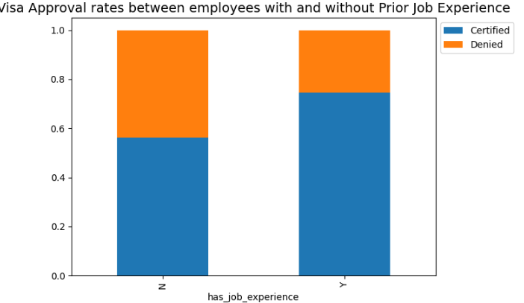
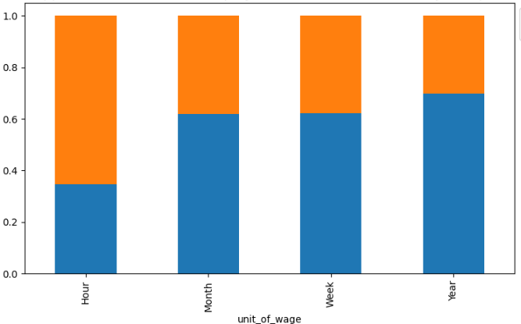
EDA Results – Job Experience & Unit of Wage
The unit of prevailing wage is an important factor for differentiating between a certified and a denied visa application. ● If the unit of prevailing wage is Yearly, there's a high chance of the application getting certified.
Around 75% of the applications were certified for applicants who have a yearly wage unit. While only 35% of the applications were certified for applicants who have an hourly wage.
Having job experience seems to be a key differentiator between visa applications getting certified or denied.
Around 80% of the applications were certified for the applicants who have some job experience, as compared to the applicants who do not have any job experience.
Applicants without job experience saw only 60% of their visa applications getting certified.

Slide 10
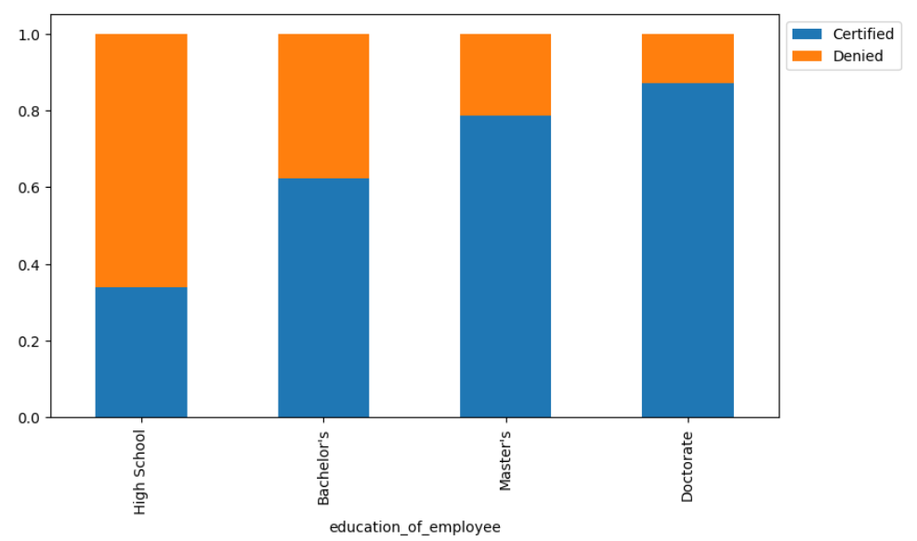
Time spent on the old vs. the new Landing page
Education seems to have a positive relationship with the certification of a visa; the higher the education, the higher the chances of a visa getting certified.
Around 85% of the visa applications got certified for the applicants with a Doctorate. While 80% of the visa applications got certified for the applicants with a Master's degree.
Around 60% of the visa applications got certified for applicants with Bachelor's degrees.
Applicants who do not have a degree and have graduated from high school are more likely to have their applications denied.

Slide 11
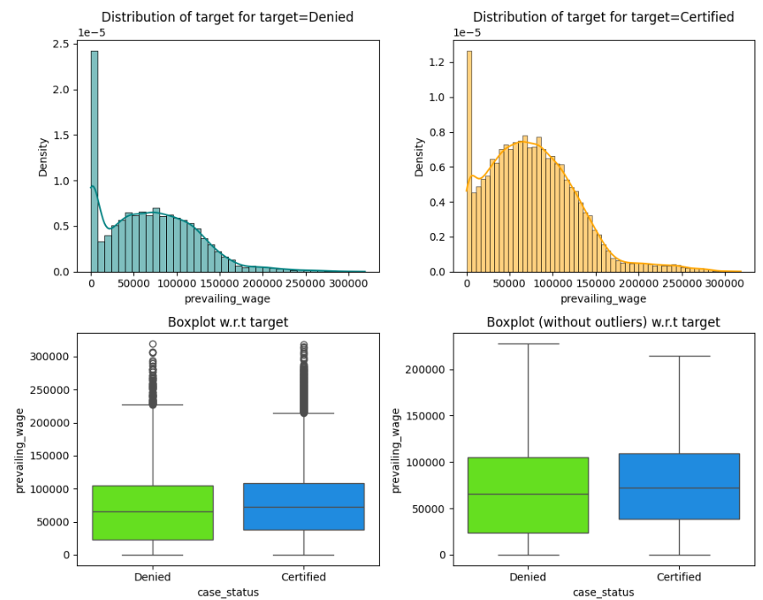
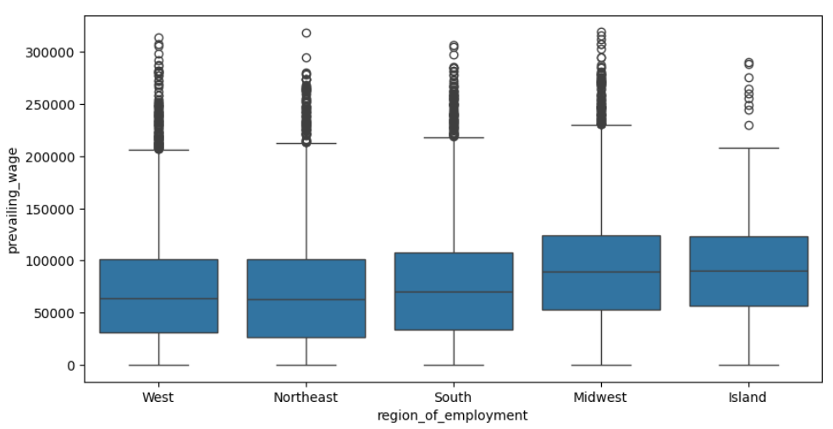
EDA Results – Converted status & Preferred Language
The Midwest and Island regions have slightly higher prevailing wages as compared to other regions.
The distribution of prevailing wage is similar across the West, Northeast, and South regions.
The median prevailing wage for the certified applications is slightly higher than that for denied applications.

Slide 12
Data Preprocessing
There were no null and duplicate values in the dataset.
The case_id column was dropped from the dataset since all the values in that column were unique.
There were some negative values in the number of employees column, which were replaced by their absolute values.
There were quite a few outliers in the data, however, they were not treated since they were genuine values.
The values in the case_status column were encoded - if the application is certified, the value was changed to 1. Similarly, if the application was denied, the value was changed to 0.
For preparing the data for modeling, we first split the data into 2 parts, temporary and test in an 80:20 ratio as an intermediary step. After this, the temporary dataset is again split into training and validation sets in the ratio of 75:25

Slide 13
Model Evaluation Criterion
We are interested in predicting whether a visa application is certified or denied
The two cases here where the model can make wrong predictions and the corresponding
consequences are:
False Positives: If a visa is certified when it has to be denied, the wrong employee will get the job position, while US citizens will miss the opportunity to work in that position.
False Negatives: If a visa is denied when it has to be certified, the U.S. will lose a suitable human resource that can contribute to the economy.
Both cases are equally important; as such, we want the F1 score to be maximized.
The greater the F1 score, the higher the chances of minimizing both false positives and false negatives

Slide 14
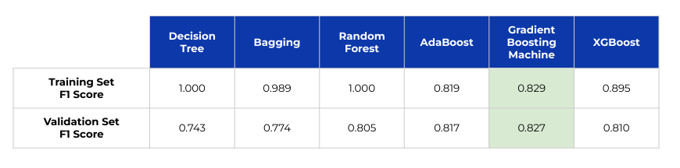
Model Building - Original Data
We start by building multiple ML models with the original data at hand. ● The models built and their performance score are provided below.
The Gradient Boost classifier has a good performance and best generalization, followed by the AdaBoost classifier and XGBoost classifier, respectively.

Slide 15
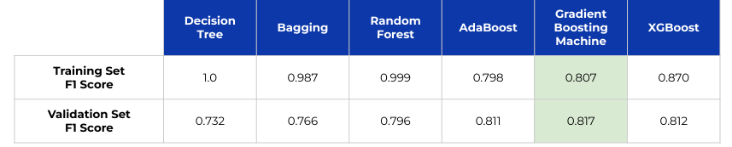
Model Building - Oversampled Data
Since the classes are imbalanced, we try addressing this using oversampling first.
SMOTE (Synthetic Minority Over-sampling Technique) is used to oversample the minority class data to the same proportion as the majority class
We then build the same models as before using the oversampled data.
The Gradient Boost classifier has a good performance and best generalization, followed by the XGBoost classifier and AdaBoost classifier, respectively.

Slide 16
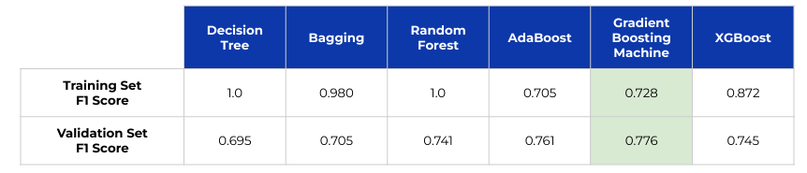
Model Building - Undersampled Data
We then try addressing class imbalance using undersampling first.
Random Undersampling is used to undersample the majority class data to the same proportion as the minority class
We then build the same models as before using the oversampled data
The Gradient Boost classifier has a good performance and best generalization, followed by the AdaBoost classifier and XGBoost classifier, respectively.

Slide 17
Model Performance - Observations
Gradient Boosting, XGBoost, and AdaBoost models demonstrate consistent and good performance along with much better generalization capabilities than the other 3 models for all 3 datasets - the original, the oversampled, and the undersampled.
So, we will tune these three models to see if we can improve their performance.
We will also try to tune the random forest model and see if we can solve the problem of overfitting and enhance its performance.
We will tune the Gradient Boosting classifier and AdaBoost classifier using the original data, as it gives better results for these two models.
The XGBoost classifier and Random Forest classifier will be tuned using the oversampled data.

Slide 18
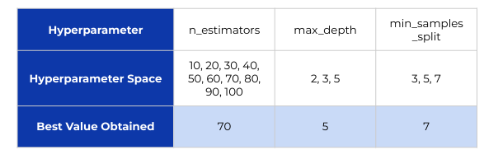
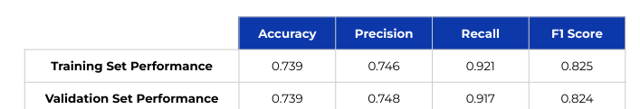
Tuning Random Forest Classifier
Grid Search with cross-validation was used for hyperparameter tuning
The hyperparameter space checked and best hyperparameters obtained are as follows
The performance of the tuned Random Forest model is as follows:

Slide 19
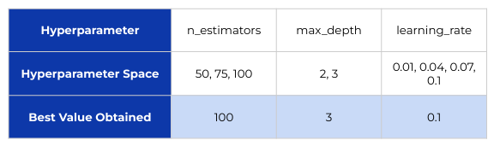
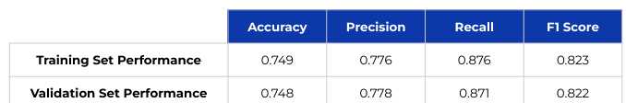
Tuning AdaBoost Classifier
Grid Search with cross-validation was used for hyperparameter tuning
The hyperparameter space checked and best hyperparameters obtained are as follows
The performance of the tuned AdaBoost model is as follows:

Slide 20
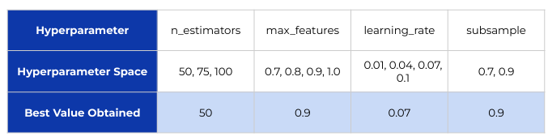
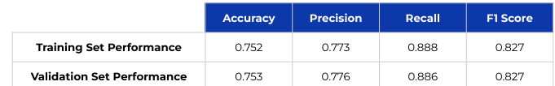
Tuning Gradient Boost Classifier
Grid Search with cross-validation was used for hyperparameter tuning
The hyperparameter space was checked, and the best hyperparameters obtained are as follows
The performance of the tuned Gradient Boost model is as follows:

Slide 21
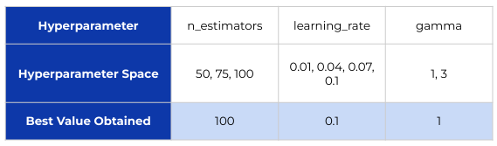
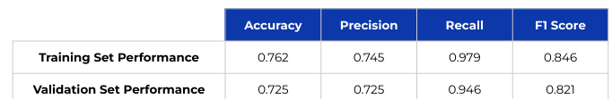
Tuning XGBoost Classifier
Grid Search with cross-validation was used for hyperparameter tuning
The hyperparameter space was checked, and the best hyperparameters obtained are as follows
The performance of the tuned XGBoost model is as follows:

Slide 22
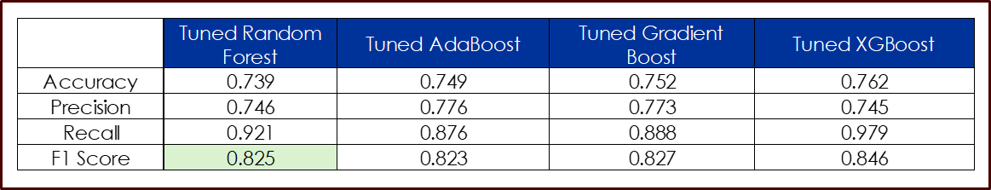
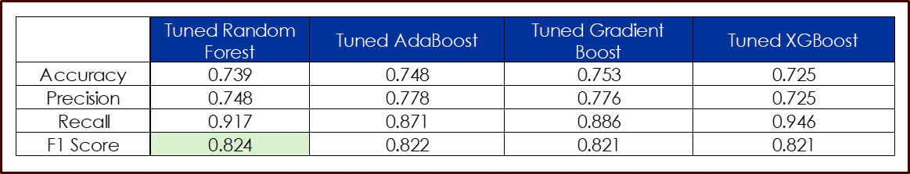
Model Performance Comparison
Training Performance
Validation Performance

Slide 23
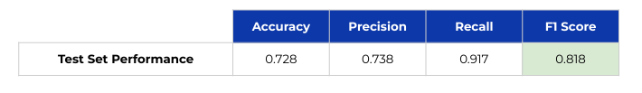
Final Model Selection
The tuned Random Forest classifier exhibits the best performance for visa approval prediction.
Since the Tuned Random Forest classifier gave the best and generalized performance on the test dataset, we will use it as our final model.
The test set performance of the tuned Random Forest model is as follows:

Slide 24
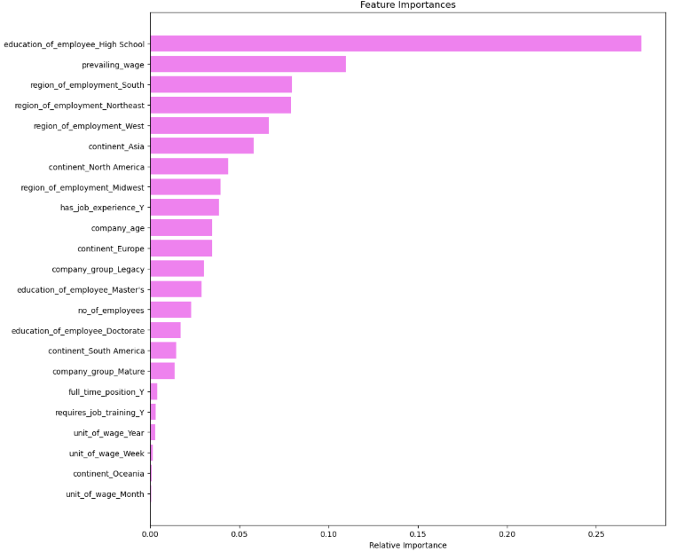
Random Forest Classifier - Feature Importances
The top 3 attributes affecting the tuned Random Forest model’s visa approval predictions are:
1. education_of_employee_High School: This is a
categorical feature in the Random Forest model indicating the employee's education level to be high school.
2. prevailing_wage: Average wage paid to similarly
employed workers in a specific occupation in the area
of intended employment.
3. has_job_experience_Y: This variable indicates
that the employee holds prior job experience.
While other attributes may impact model performance, the above features are more likely the key determinants of visa application approval or denial.

Slide 25
Actionable Insights
Education Level: Applicants with at least a Bachelor's degree have a higher likelihood of visa approval. Advanced degrees such as Master's and Doctorates increase approval chances even further, especially in specific regions.
Job Experience: Having job experience is a critical factor for visa certification. Applicants with no prior work experience are more likely to have their applications denied.
Prevailing Wage: The median prevailing wage for certified applicants is around $72,000, indicating that a higher wage corresponds to greater visa approval chances. In contrast, those with a prevailing wage of around $65,000 are more likely to face denial.
Unit of Wage: Applications with a yearly wage unit have a higher chance of approval compared to those with hourly wages. Hourly wage applicants are more often associated with denied applications.
Regional Employment Trends: Visa approval rates vary by region. The Midwest shows higher approval rates, while educational requirements differ by region:
High school diploma: More required in the South and Northeast.
Bachelor's degree: Primarily sought in the South and West.
Master's degree: Mostly required in the Northeast and South.
Doctorates: Mainly in demand in the West and Northeast.

Slide 26
Recommendations
Target Higher Education Profiles: Focus on applicants with at least a Bachelor's degree, and prioritize Master's or Doctorate holders, particularly for applications in regions like the Northeast and West where advanced degrees are in higher demand.
Encourage Competitive Wage Offers: Employers should aim to offer salaries at or above the median prevailing wage of $72,000 to enhance visa approval chances. Conducting market research to align wages with industry standards may also help improve certification rates.
Prioritize Yearly Wage Unit: Companies should consider offering yearly wage packages rather than hourly wages to increase the likelihood of visa approval. A shift toward yearly wages aligns with successful applicant profiles.
Leverage Regional Employment Needs: Tailor applicant recruitment based on regional demand. For example, focus on high school graduates for Southern regions and Master's degree holders for the Northeast. This targeted approach could improve visa success rates by addressing specific regional talent shortages.
Gather More Detailed Applicant Information: Employers should collect and analyze additional details about candidates, such as their field of specialization and years of experience. This data can provide deeper insights and help in making better hiring decisions, leading to higher chances of visa approval.

Slide 27
Appendix

Slide 28
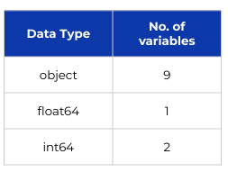
Data Overview
The dataset has 25480 rows and 12 columns
The dataset does not have any null or duplicate values.
The datatypes of the different columns of the dataset are given below:
The case_id contains unique identifiers for each row. This column is dropped from the data as it is not useful for any model building or EDA processes.

Slide 29
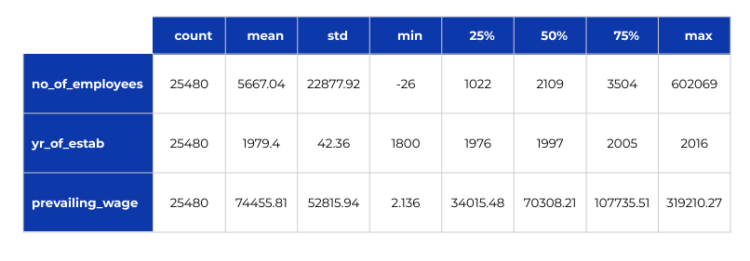
Data Overview
The statistical description of the numerical columns of the dataset is given below.

Slide 30
Data Overview
From the descriptive statistics, we can conclude that:
The range of the number of employees in a company is huge. There are some anomalies in the data, as it was observed that the minimum number of employees is equal to -26, which is not possible. Hence, it needs fixing with absolute values.
The year of establishment of companies ranges from 1800 to 2016, which seems fine.
The average prevailing wage is 74455.81. There's also a very huge difference in the 75th percentile and maximum value which indicates there might be outliers present in this column.
We fix the negative values in the no_of_employees column by taking their absolute values.

